Slide 1

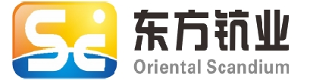

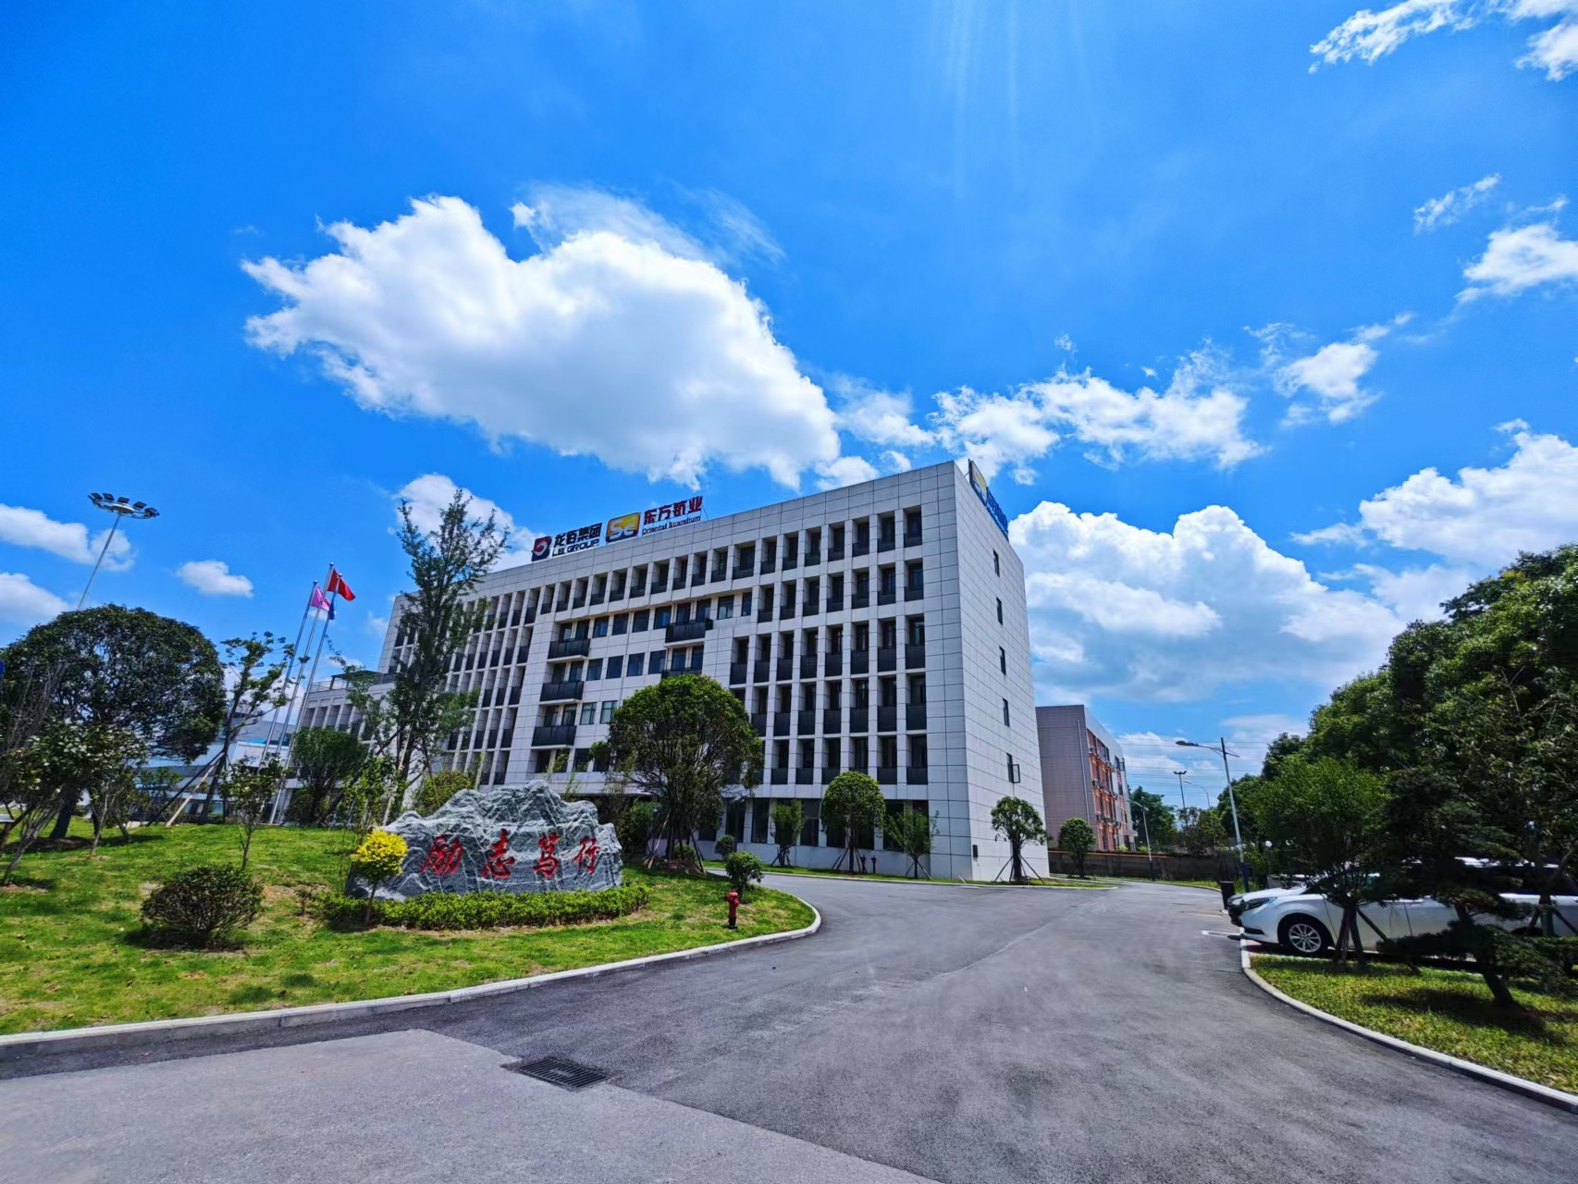
Analysis on the
Current Situation and
Development Trend of
the Scandium Industry
Hunan Oriental Scandium Industry Co., Ltd.
General Manager: Nie Donghong
Date：2026/05/15

Slide 2


01
Scandium Raw Material Supply Landscape
02
Demand Structure and Growth
CONTENTS
03
Main Contradictions of the Industry
04
Future Development Path Deduction
05
Conclusions and Prospects

Slide 3

01
Scandium Raw Material Supply Landscape

Slide 4
Domestic scandium oxide production capacity is highly concentrated
with potential supply reaching nearly 200 tons
Enterprises with self-owned raw materials have a production capacity of over 125 tons
Purification Enterprises and Supplementary Supply of Nickel-Cobalt Resources
There are only 5 to 6 domestic enterprises that possess self-owned scandium raw material sources such as titanium dioxide waste acid, zirconium solution waste acid, and nickel-cobalt waste by-products, and have achieved mass production of scandium oxide. Their total production capacity exceeds 125 tons. Recently, one enterprise has withdrawn from the market, leading to a slight contraction in actual effective capacity.
About 8 enterprises in the nickel-cobalt industry can provide scandium-bearing materials, equivalent to approximately 100 tons of scandium oxide in resource volume. Another 4 enterprises have purification capacity but no self-owned raw materials, with an estimated production capacity of 70 tons. The overall potential supply capacity of domestic scandium oxide totals nearly 200 tons.
01
02

Slide 5
Overseas production capacity is limited
and high costs constrain the commercialization process.
03
02
01
Costs far exceed market prices, making project implementation difficult.
Exploration projects are rich in resources but difficult to put into production.
The existing overseas production capacity is only about 13 tons.
According to overseas industry insiders, the feasibility study report of Sunrise Energy shows that the production cost of scandium oxide reaches as high as USD 3,000 per kilogram, far exceeding the current market price, making it difficult to form a stable commercial supply in the short term.
Multiple scandium mine projects in Europe, the United States, Canada and Australia are currently in the feasibility study stage, with claimed resource reserves of 30,000 to 40,000 tons. Nevertheless, they are featured by high investment intensity and high extraction costs, leaving their commercialization prospects uncertain.
Currently, there are only three overseas scandium oxide manufacturers, mainly located in Japan, Canada and Russia, with a combined capacity of about 13 tons, representing a significant scale gap compared with China.

Slide 6
02
Demand Structure and Growth

Slide 7

2026 Global Demand: 60–80 Tons; SOFC as Core Driver
SOFC accounts for over 75%, ranking as the largest growth driver
01
Solid Oxide Fuel Cells (SOFCs) represent the largest application field of scandium oxide. Driven by the strong power demand from AI computing centers, its market share is expected to exceed 75% in 2026, with outstanding technical advantages and high growth certainty.
Aluminum-scandium alloy accounts for about 15% and maintains steady growth
Demand for Al-Sc alloy in aerospace, 3D printing and 3C industries accounts for about 15%. It delivers remarkable performance improvement but is constrained by costs, and breakthroughs are yet to be achieved in the civilian market.
02
Diversified applications including target materials and optics account for 10%
03
Niche segments such as Al-Sc alloy target materials, laser crystals, optical coatings, thermal barrier coatings and catalysts collectively account for about 10%, featuring limited market capacity yet high added value.

Slide 8
SOFC boasts strong demand stickiness and large consumption volume, while the Al-Sc alloy sector is highly cost-sensitive and awaits market breakthroughs
SSOFC has a long certification cycle but boasts extremely high customer stickiness.
Al-Sc alloy features excellent performance, while cost constraints restrict its expansion in the civilian market.
The solid oxide fuel cell (SOFC) sector features high technical barriers to entry and lengthy customer certification cycles. Once integrated into the supply chain, enterprises can secure extremely high customer stickiness and stable recurring orders. SOFC will serve as the most promising anchor application for the scandium industry in the future, with prominent strategic value.
Al-Sc alloys are highly cost-sensitive. Trace dosage can significantly improve material performance. Demand from the aerospace industry remains stable, while the 3D printing sector sees marked growth. Nevertheless, the large-scale commercialization of Al-Sc alloys in the civilian 3C market still requires further cost reduction to achieve breakthroughs.

Slide 9
Characteristics of Other Application Fields
Optical and laser applications demand extremely high material purity
The optical and laser sectors set stringent requirements on the purity and batch-to-batch stability of scandium oxide, with remarkable customer certification barriers. The industry features strong price tolerance but limited market capacity.
Demand in the lighting sector is shrinking year by year
Demand for traditional lighting applications such as high-performance metal halide lamps continues to decline. A small number of orders will remain in the short term, while the long-term phasing-out trend is definitive.
Demand for Al-Sc alloy targets is concentrated in overseas markets
Al-Sc alloy targets for filters have limited overall market demand, with consumption mainly concentrated in overseas markets. Domestic related technologies are still in the verification stage, and the outlook for future growth remains uncertain.
Thermal barrier coatings have an extremely long verification and qualification cycle
High-end thermal barrier coatings need to undergo rigorous and lengthy customer verification to replace traditional materials. It is difficult to achieve volume release in the short term, yet there is considerable substitution potential in the long run.

Slide 10
03
Main Contradictions of the Industry

Slide 11
The market features a structural imbalance between supply and demand, with severe overcapacity of mid- and low-end products
Overcapacity is prominent in mid-to-low-end products
The market clearly presents an overall pattern of supply exceeding demand
Mid-to-low-end scandium oxide products feature low technical barriers and are easy to manufacture. The influx of numerous enterprises has led to particularly severe overcapacity in this segmented market, accompanied by white-hot price competition, which has become the primary root cause weighing on the industry’s overall profitability.
China’s potential supply capacity of scandium oxide approaches 200 tons, while global demand is only 60 to 80 tons in 2026. There is a huge supply-demand mismatch. The industry as a whole presents a clear oversupply landscape, and sustained price pressure has become the norm.

Slide 12
Leading enterprises maintain price stability amid low-price involution and the market competition order is in urgent need of regulation
Leading enterprises are committed to stabilizing prices and ensuring product quality
Industry-leading enterprises adhere to the quality-first strategy. By maintaining long-term customer relationships, they strive to guide the pricing system back to rationality.
Small and medium-sized enterprises disrupt the market via cutthroat low-price competition
Some SMEs and new market entrants adopt aggressive low-price strategies to seize market share for rapid capital recovery, resulting in inconsistent product quality.
Disordered pricing system erodes overall industry profits
Low-price involution undermines the fair competition environment and distorts price signals. The overall profit margins of the industry are severely squeezed, hindering its sound and healthy development.

Slide 13
High-end business flows outward while the low-end market falls into involution, and disparities in environmental protection costs further exacerbate industrial differentiation
Leading enterprises dominate the overseas high-end market
Leveraging advantages in quality, certification and channels, leading enterprises have successfully entered the supply chains of overseas high-end customers and secured stable orders.
SMEs are trapped in the domestic low-end market
Leading enterprises have seen their environmental protection investment grow several times over
Small enterprises secure cost advantages at the expense of environmental compliance
SMEs lacking core competitiveness can only target domestic price-sensitive customers, falling into a vicious cycle of low-price competition and low profitability.
Leading enterprises invest heavily in three-waste treatment and cleaner production. Their environmental cost per ton has surged several times, and the pressure of compliant operation keeps intensifying.
Some small enterprises have inadequate environmental protection facilities. They cut production costs at the expense of the environment, further disrupting the order of fair competition.

Slide 14
04
Future Development Path Deduction

Slide 15


Leading enterprises take the lead in resource integration and the industry has entered a stage of orderly concentration
Bind major downstream customers to stabilize demand
Carry out mergers, acquisitions and equity participation to control upstream resources
The rise of industry concentration ratio drives market prices to gradually stabilize
Leading enterprises deepen strategic cooperation with core downstream customers such as SOFC, consolidating the fundamental demand base.
By conducting mergers, acquisitions or equity participation in SMEs with scandium resources, leading enterprises extend their business layout upstream, and strengthen their bargaining power over raw materials as well as supply security.
Upon the completion of resource integration, the industry has entered a phase of orderly concentration where the strong grow stronger. Malignant competition has eased, and the pricing system is moving toward stable and sound development.

Slide 16
Weaker-than-expected demand triggers industrial reshuffling
and the survival of the fittest rebuilds market equilibrium
The price war has triggered a sharp decline in industrial profits
After industrial reshuffling, supply and demand regain balance and profitability recovers
Leading enterprises achieve a turnaround against the industry downturn by virtue of their advantages in capital, technology and customer resources. Most small and medium-sized enterprises are forced to withdraw from the market due to cost inversion. After a reshuffle cycle of two to three years, supply and demand in the industry rebalance, and the profitability of surviving enterprises gradually recovers.
If the growth rate of demand falls short of expectations, leading enterprises and SMEs will be embroiled in a full-scale price war. The overall profit margin of the industry will be drastically compressed, some enterprises will face the risk of cash flow rupture, and market clearing pressure will surge sharply.

Slide 17


National strategic resources are subject to unified state regulation and control, adopting quota-based production and targeted supply arrangements
Implement quota-based production and conduct targeted supply to core fields
State-owned capital platforms take the lead in production capacity acquisition and reserve
The industry landscape tends to stabilize, which may constrain industrial vitality
The state may acquire and stockpile major production capacity through state-owned capital platforms or central SOE integration funds, and incorporate scandium into the national strategic resource management system.
Implement a mechanism of quota production and targeted supply, and give priority to guaranteeing the raw material demand security of key fields such as aerospace and new energy.
The industry sees improved operational stability, while market-oriented competition and innovation vitality may be constrained.

Slide 18
Implement a mechanism of quota production and targeted supply, and give priority to guaranteeing the raw material demand security of key fields such as aerospace and new energy
Multinational enterprises are reducing their reliance on China
Force industries to transform and upgrade toward high value-added segments
Overseas local scandium oxide projects have been commissioned one after another. To diversify supply chain risks, some multinational enterprises have proactively reduced reliance on supplies from China. Traditional market shares of Chinese enterprises in overseas high-end markets are confronted with severe squeezed pressure.
The widening price gap between domestic and overseas markets will force domestic enterprises to accelerate the transformation into high value-added industries, and reshape international competitiveness via technological and industrial upgrading.

Slide 19

Policy adjustments in nickel and cobalt resource-rich countries force the transformation of domestic raw material structure
The retention risk of overseas scandium resources is on the rise
Indonesia and other core nickel-cobalt resource countries have rolled out increasingly stringent policies. They may restrict raw material exports and mandate deep processing locally within their territories, which will trigger a fundamental reshaping of China’s domestic raw material supply landscape.
Waste acid generated from titanium dioxide and zirconium liquid production has become the absolutely dominant source
The raw material structure of China’s scandium industry is forced to transform, and scandium resources recovered from titanium dioxide waste acid and zirconium solution waste acid will become the absolutely dominant supply source.
Technical routes and cost structure are undergoing profound adjustment
The shift in raw material sources will profoundly reshape enterprises' extraction technical routes and cost structures, highlighting the growing urgency of supply chain security and diversified layout planning.

Slide 20
05
Conclusions and Prospects

Slide 21

In the window period of supply-demand restructuring, strategic choices determine the destiny of enterprises
The industry is now in a critical window period
High-end upgrading, green development and industrial concentration have become the common development direction
The current scandium industry is in a critical window period featuring structural supply-demand imbalance and industrial pattern reshaping, with five major development paths evolving in an intertwined manner and facing prominent uncertainties.
Regardless of how development paths evolve, advancing toward high-end products, green production and orderly concentrated development constitutes the common trend and inevitable requirement of industrial evolution.
Enterprises need to make strategic plans in response to market trends and adopt differentiated positioning
Strategic vision determines long-term competitive position
Enterprises shall make strategic choices among price stabilization cooperation, differentiated competition and policy adaptation based on their resource endowments and technological capabilities.
Short-term price fluctuations cannot decide the final pattern of competition. Only enterprises with strategic vision that make early layout in high value-added businesses and supply chain security can stand out in the industry.

Slide 22
THANKS
感谢！

